Slide 1

CS 328 - Fall 2019
Assignment 4: Optimization Techniques in PyTorch

Slide 2
Outline:
Optimization in Pytorch
Hyper-parameter
Adam
SGD
Datasets
Implementation Steps

Slide 3
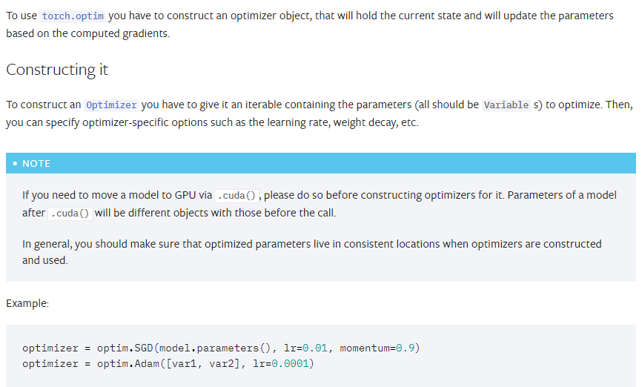
Optimization in Pytorch:
torch.optim is a package implementing various optimization algorithms. For example: Adadelta, Adagrad, Adam, SparseAdam, Adamax, ASGD, RMSprop, SGD etc
Ref: https://pytorch.org/docs/stable/optim.html

Slide 4
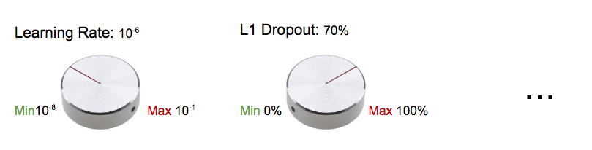
Hyper-parameter:
Hyperparameters are the knobs that you can turn when building your machine / deep learning model. .
Or,
Hyperparameters are all the training variables set manually with a pre-determined value before starting the training.
Ref: https://blog.floydhub.com/guide-to-hyperparameters-search-for-deep-learning-models/

Slide 5
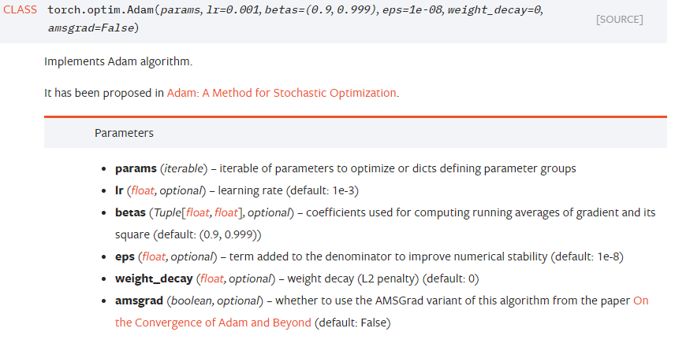
Adam:

Slide 6
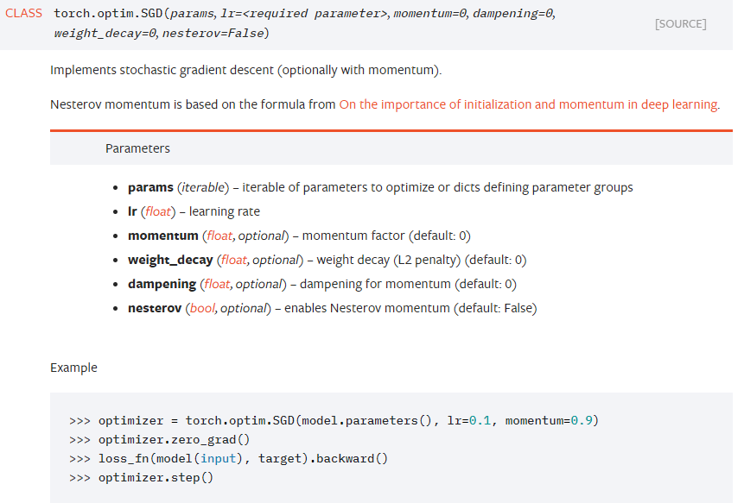
SGD

Slide 7
Datasets

Slide 8
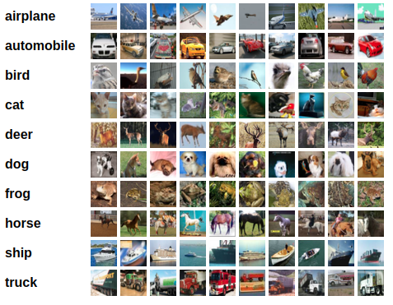
[2] CIFAR-10 Dataset
32x32 RGB images of different objects
60000 in 10 classes, with 6000 images per class, divided as 50000 training images and 10000 test images.

Slide 9
Different Data splits:
Total(60000), Test (10000), Train (50000)
Make: Train Data (45,000), and
Validation Data (5,000): Subset of the train data
Test Data: Shouldn’t be included in the training process, even for fine-tuning the hyperparameters

Slide 10
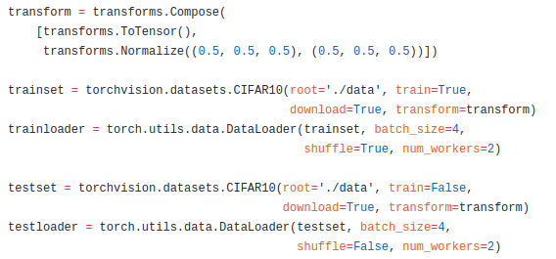
Data loaders:
An example over Cifar10 would be:

Slide 11
Implementation Steps:
Define your train, validation, and test data loaders in PyTorch
Define your model
Provide some learning_rate and momentum values for your Adam or SGD optimizer
Perform your searching (Grid search/ Random Search/…)
Choose your best-hyperparameters based on the validation set accuracy
Test the model on the test-set

Slide 12
Useful PyTorch functions:
Optimizer: Adam, SGD, etc:
Data Loader : torchvision.datasets.MNIST, torchvision.datasets.CIFAR10
random_split

